Slide 1
PHOTO EDITING - Development
CSE 611 – MS Project Development
Professor – Jinjun Xiong

Slide 2
TEAM MEMBERS
Pavana Lakshmi Venugopal
Saad Ahmed
Taraka Rohit Adusumilli
Ayesha Humaera

Slide 3
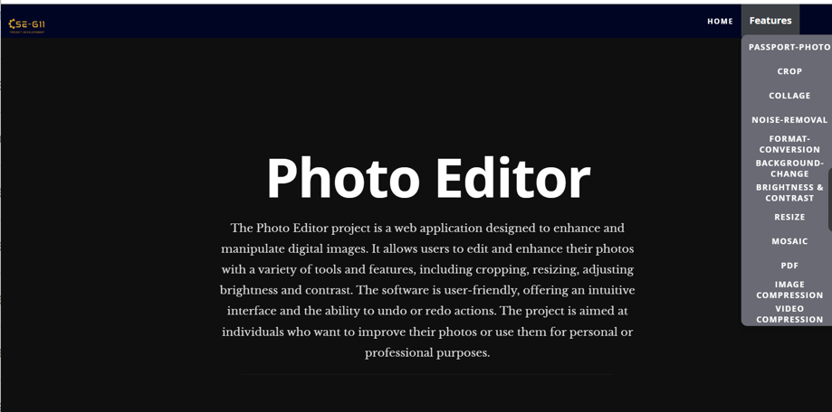
Updated Home Page

Slide 4
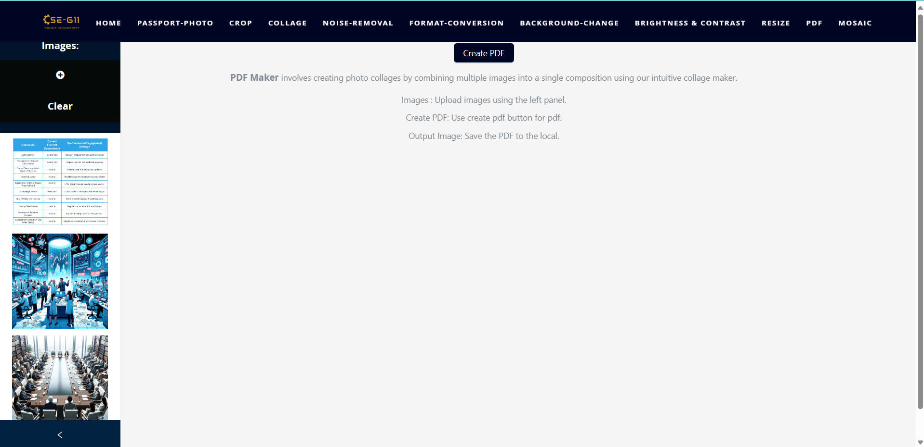
PDF Creator - Before Modernization and Fix

Slide 5
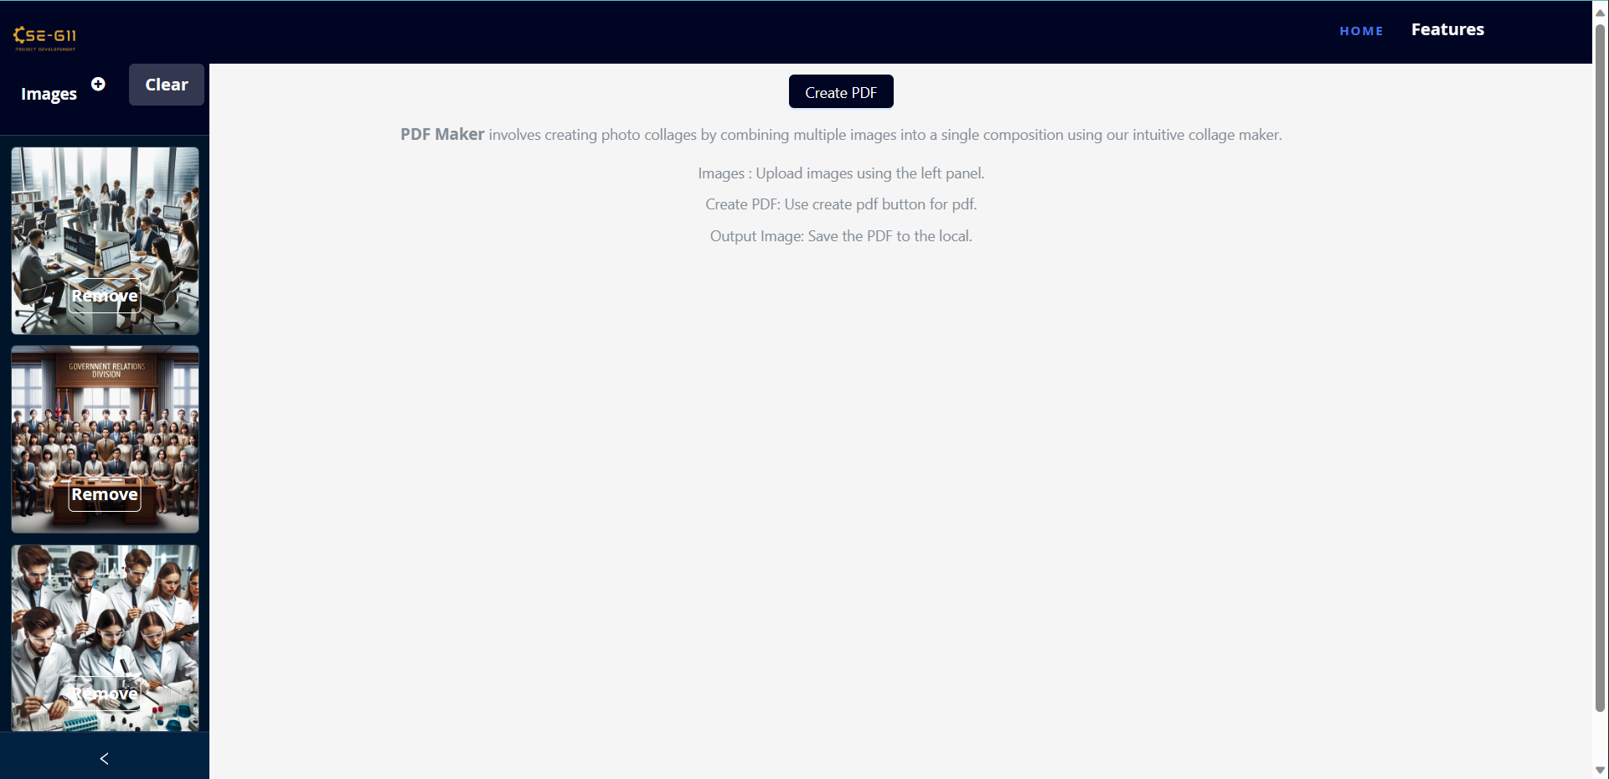
PDF Creator - After Modernization and Fix

Slide 6
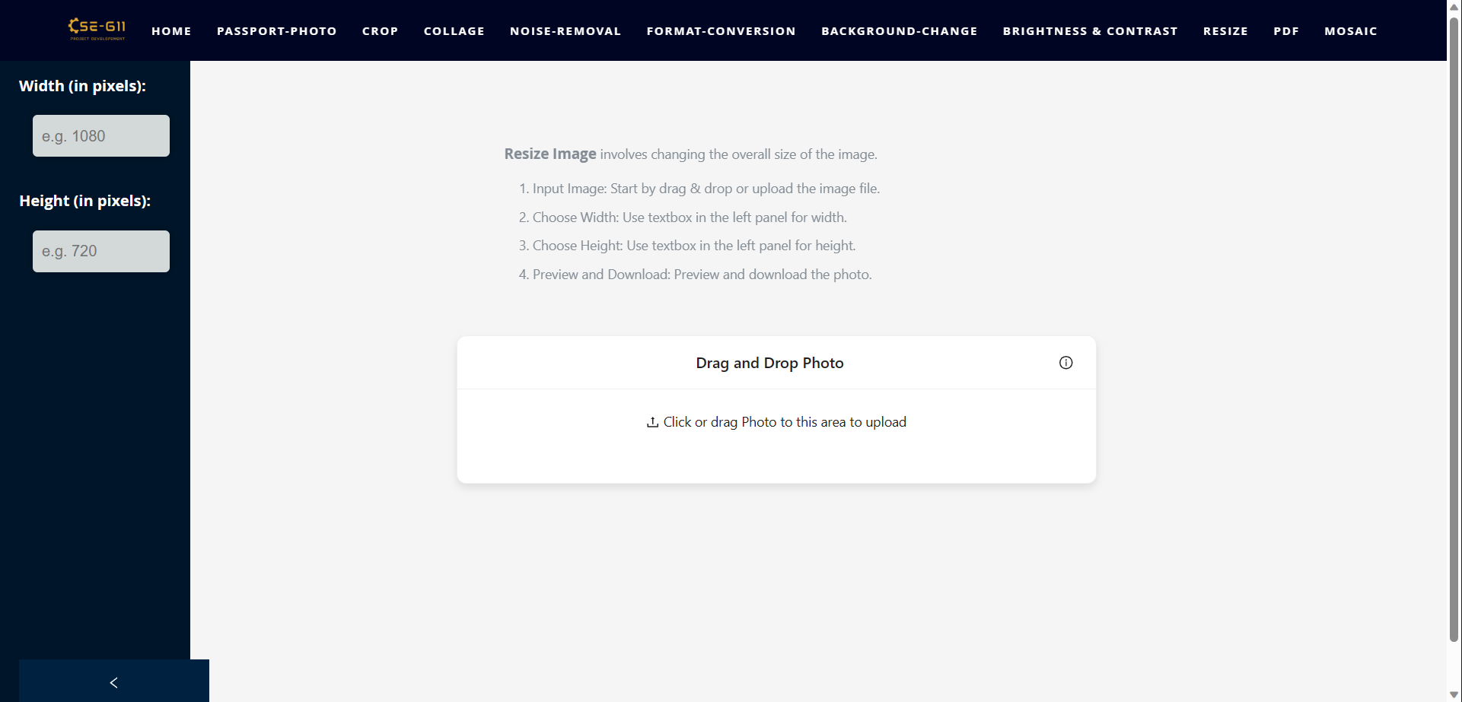
Resize Image - Before Modernization and Fix

Slide 7
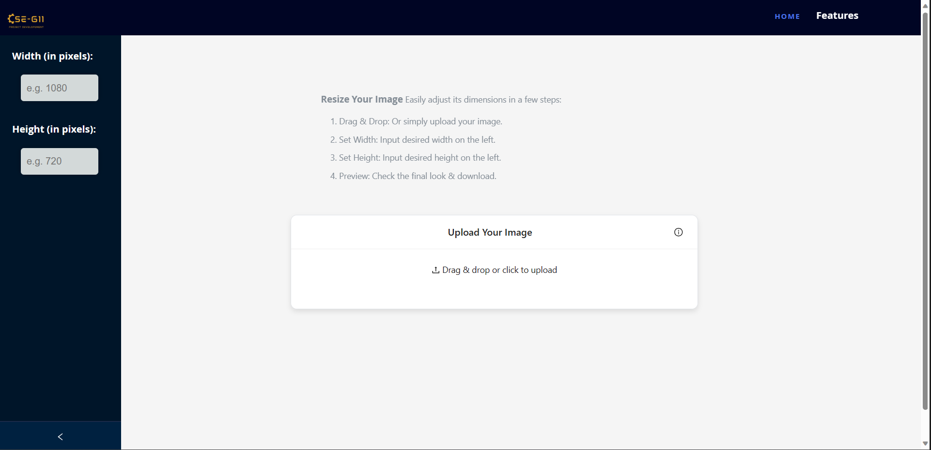
Resize Image - After Modernization and Fix

Slide 8
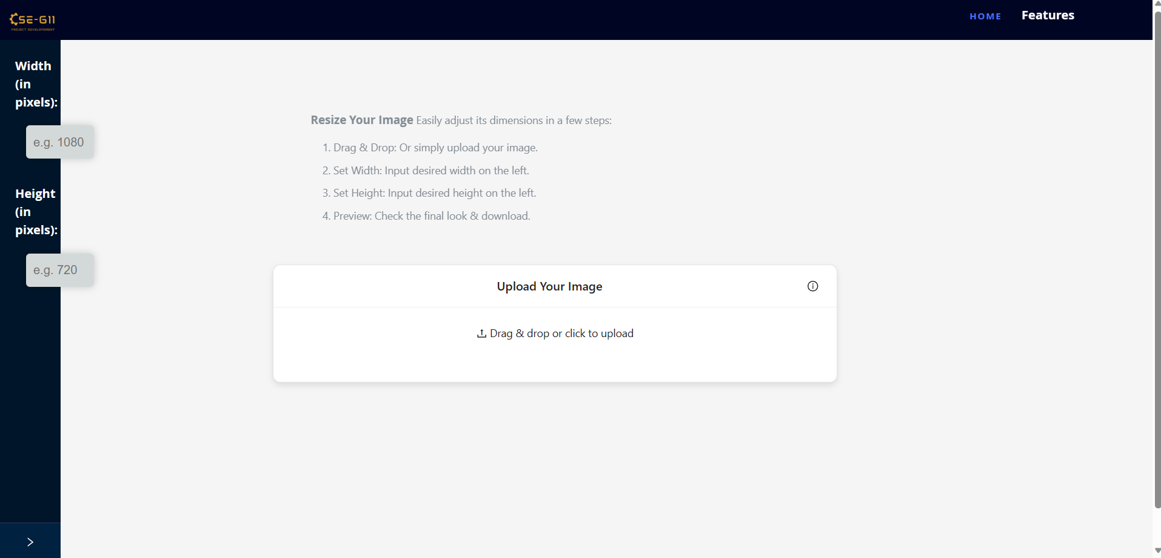
Resize Image - After Modernization and Fix

Slide 9
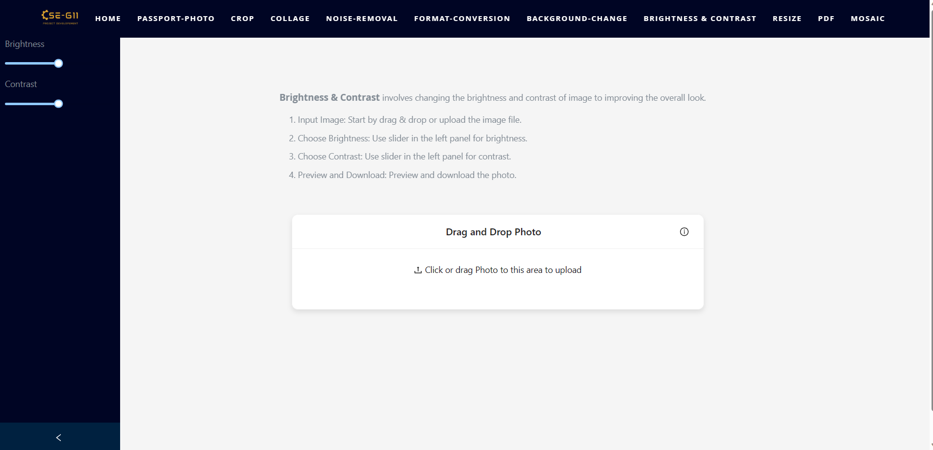
Brightness and Contrast - Before Modernization and Fix

Slide 10
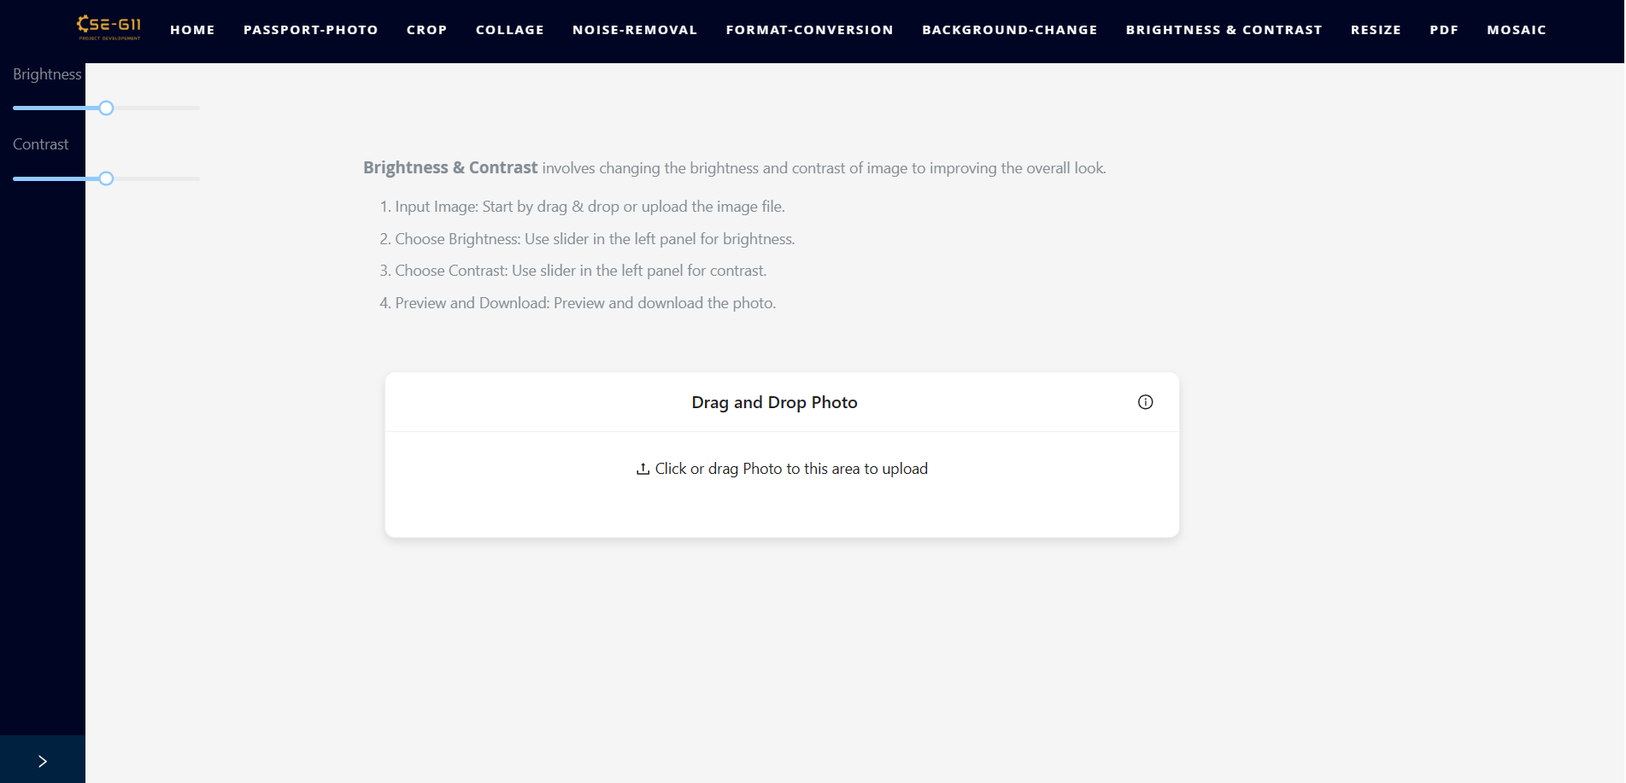
Brightness and Contrast - Before Modernization and Fix

Slide 11
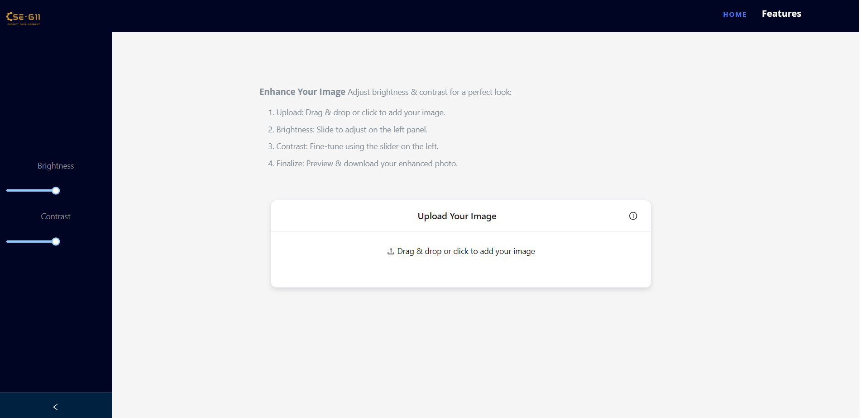
Brightness and Contrast - After Modernization and Fix

Slide 12
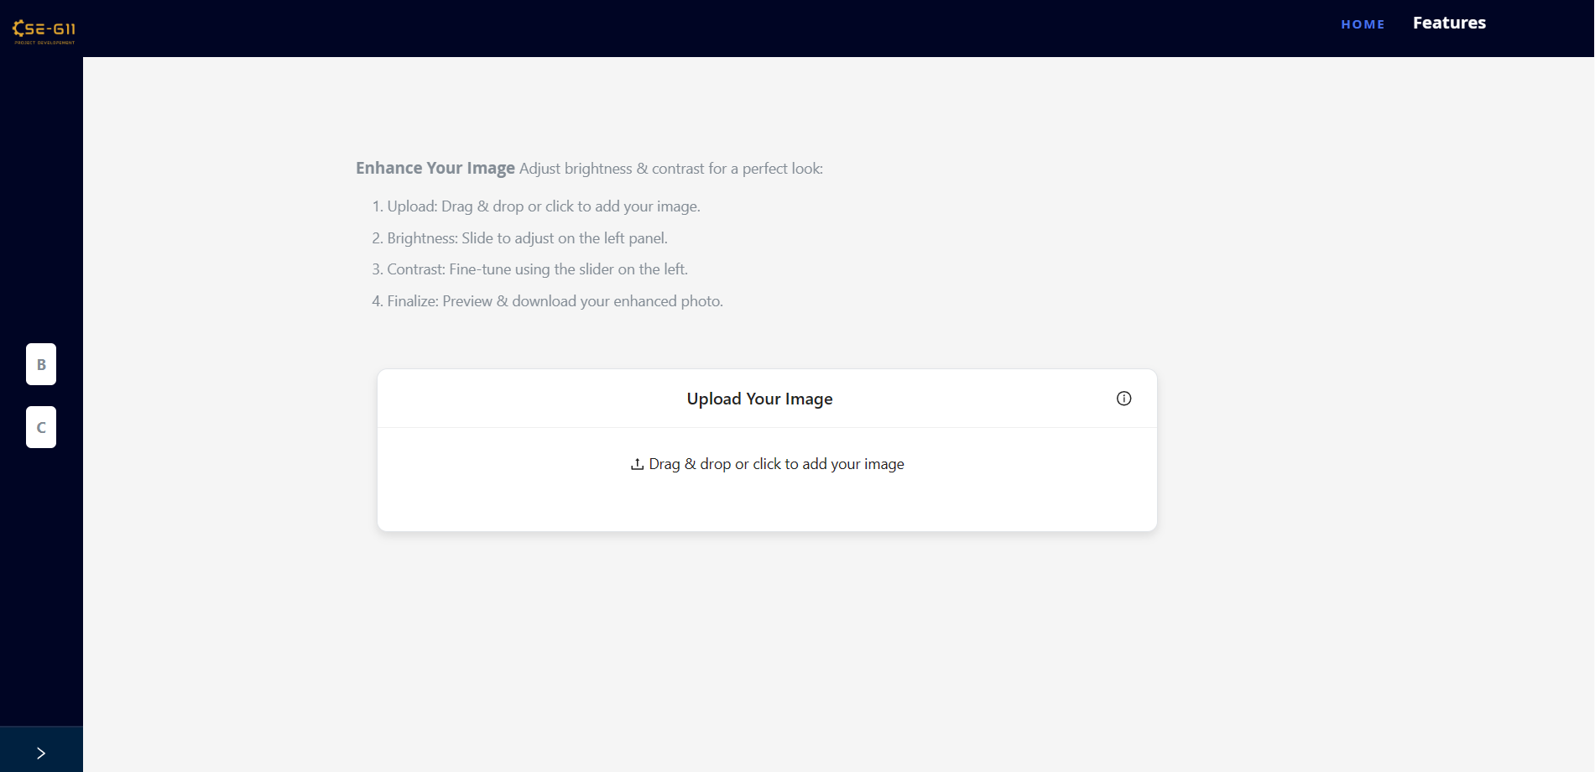
Brightness and Contrast - After Modernization and Fix

Slide 13
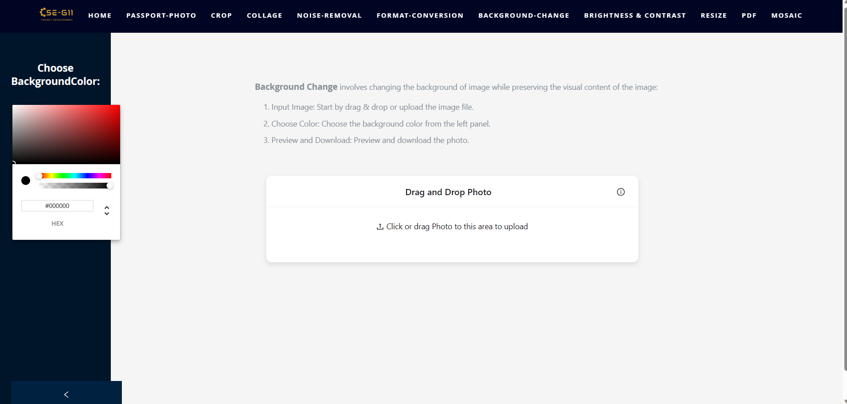
Background Change/Removal - Before Modernization and Fix

Slide 14
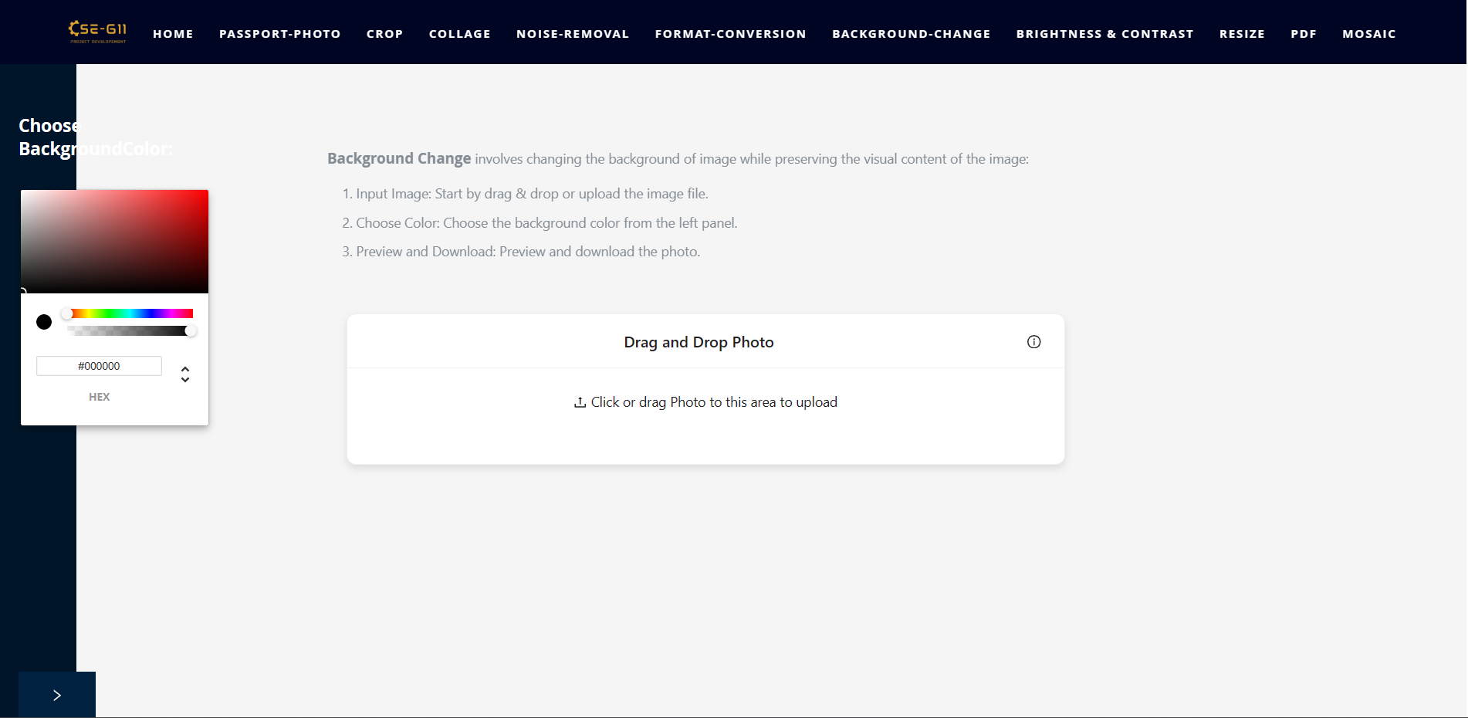
Background Change/Removal - Before Modernization and Fix

Slide 15
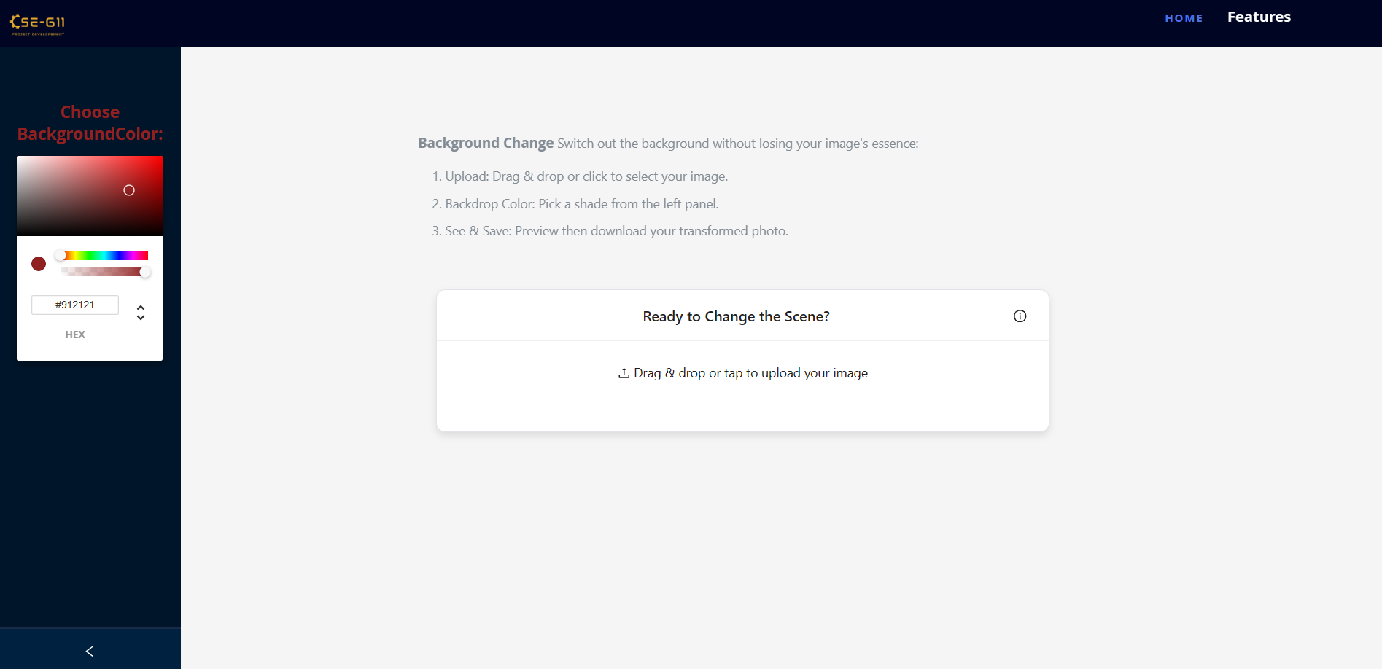
Background Change/Removal - After Modernization and Fix

Slide 16
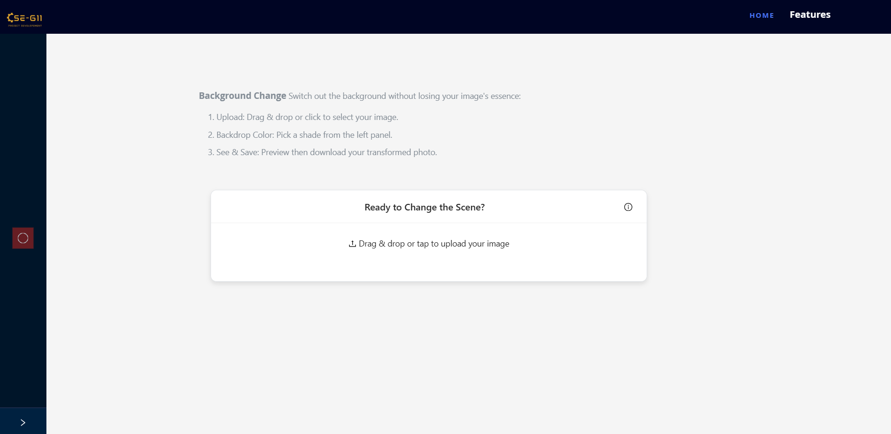
Background Change/Removal - After Modernization and Fix

Slide 17

Format Conversion - Before Modernization and Fix

Slide 18
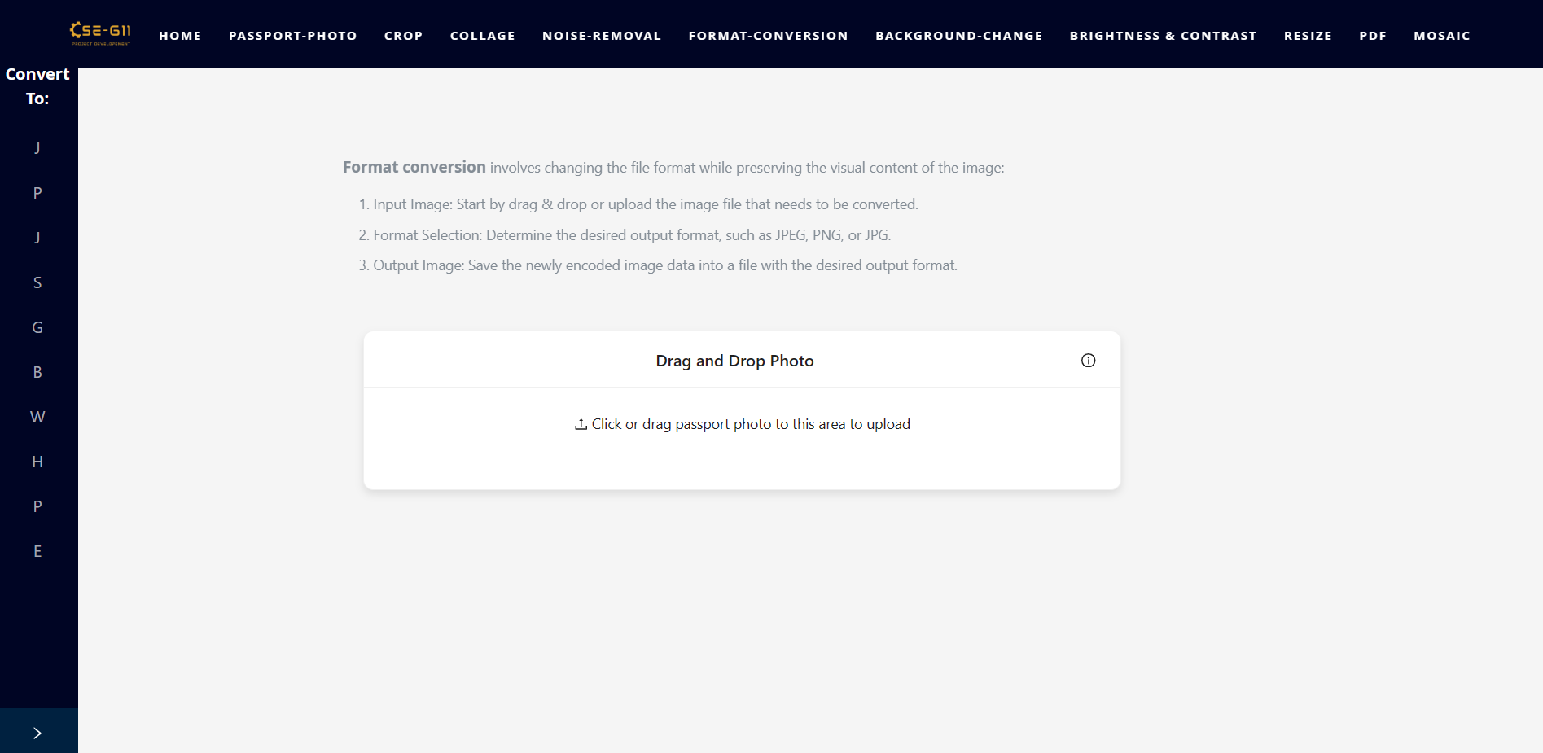
Format Conversion - Before Modernization and Fix

Slide 19
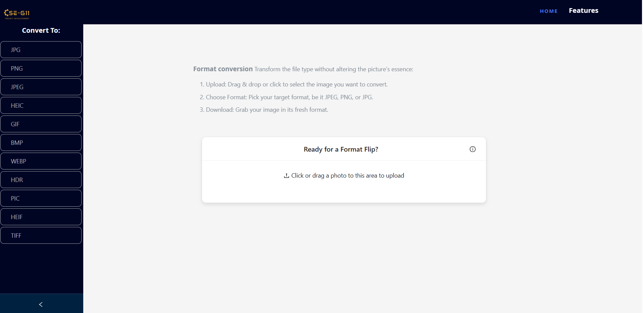
Format Conversion - After Modernization and Fix

Slide 20
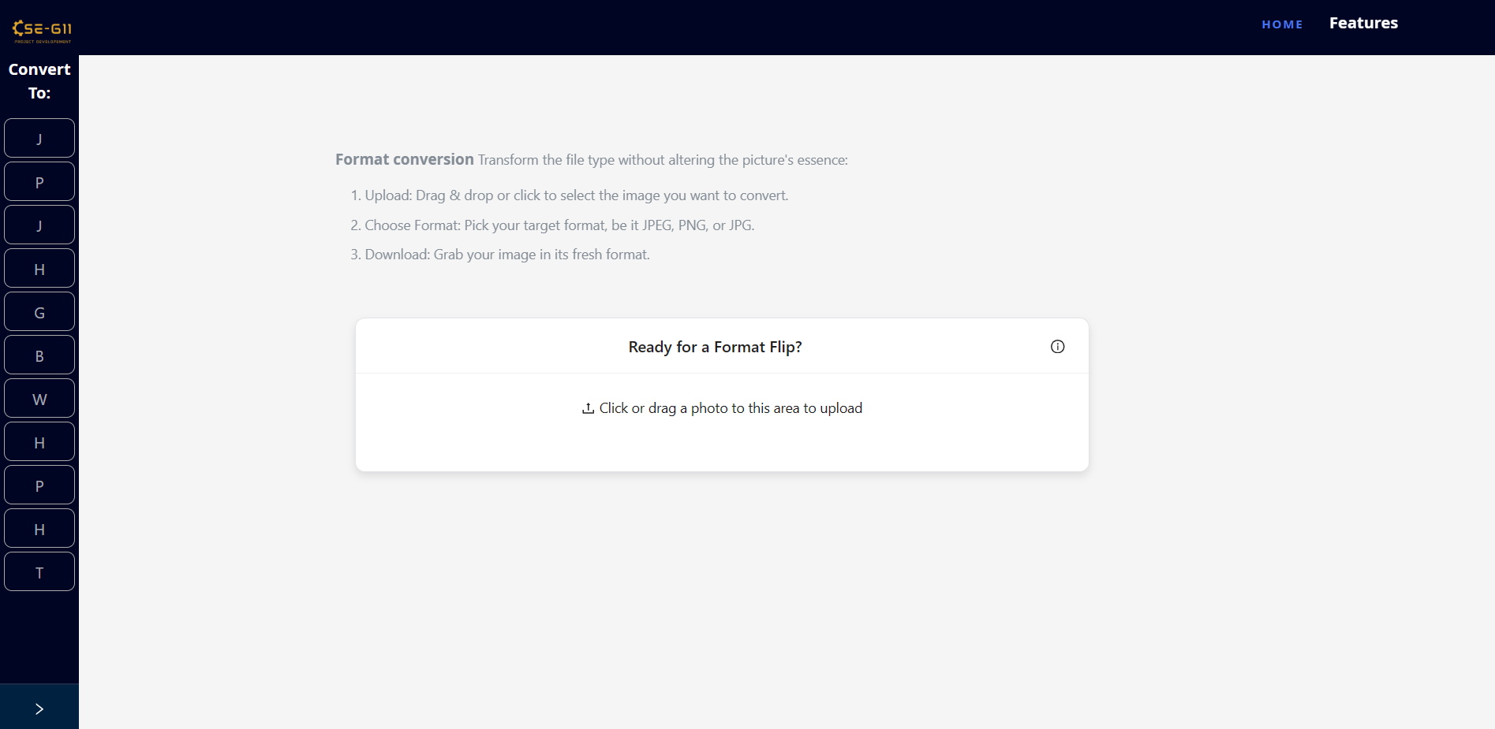
Format Conversion - After Modernization and Fix

Slide 21
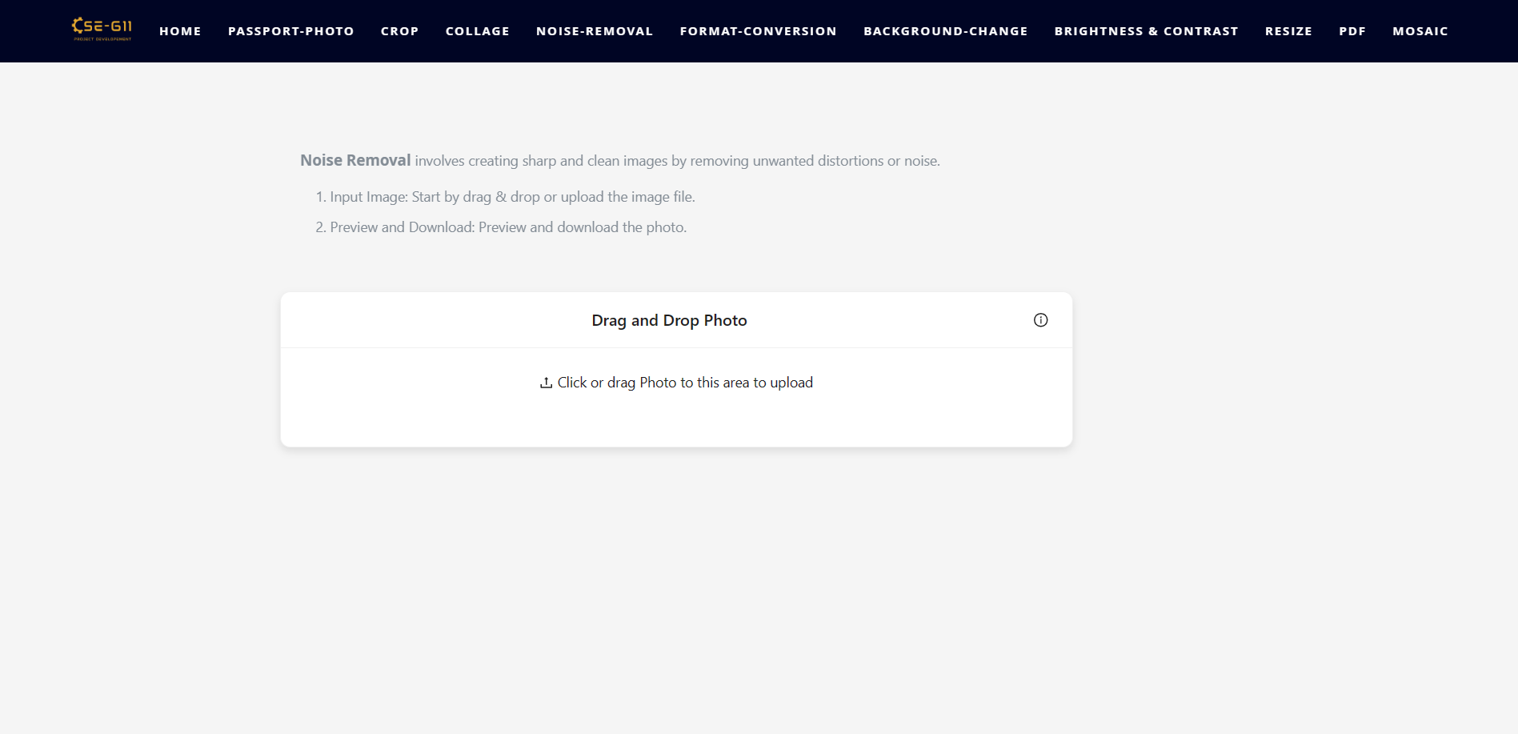
Noise Removal - Before Modernization and Fix

Slide 22
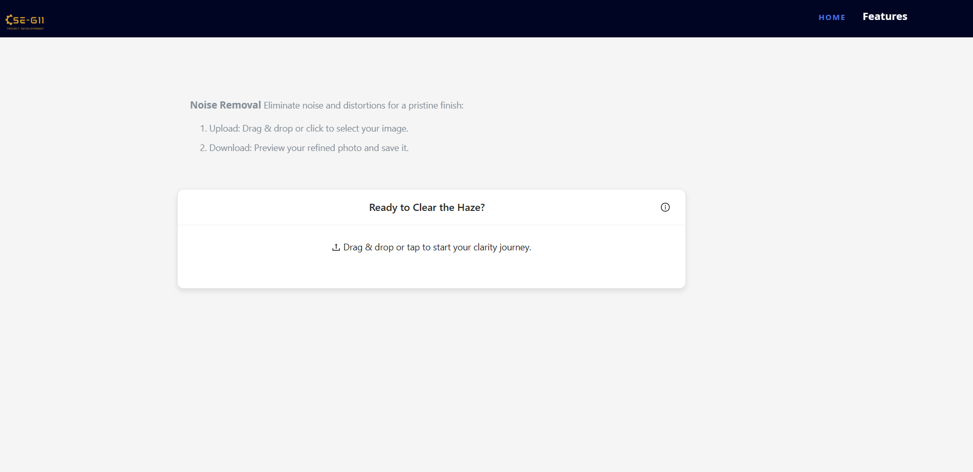
Noise Removal - Before Modernization and Fix

Slide 23
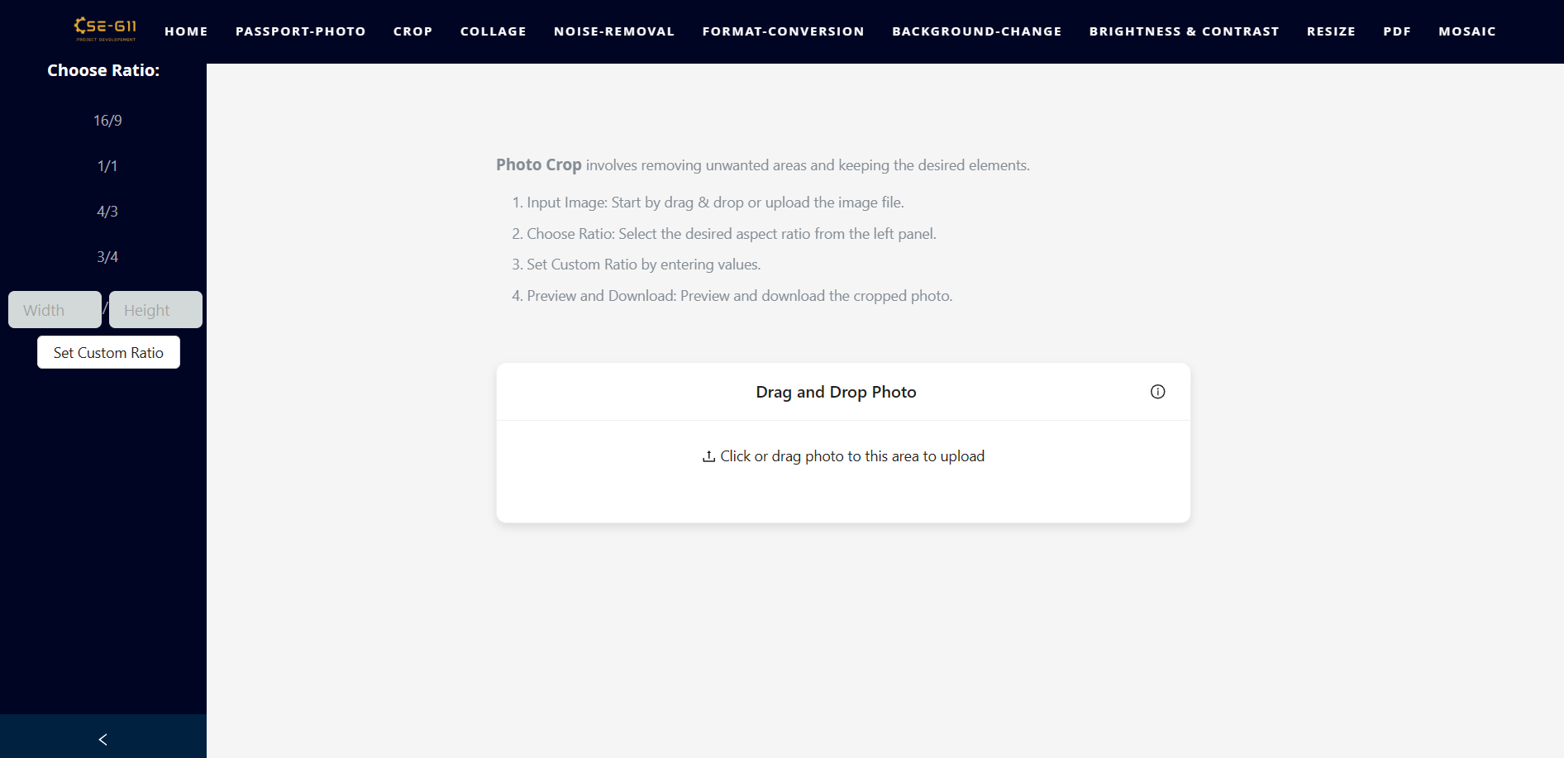
Crop - Before Modernization and Fix

Slide 24
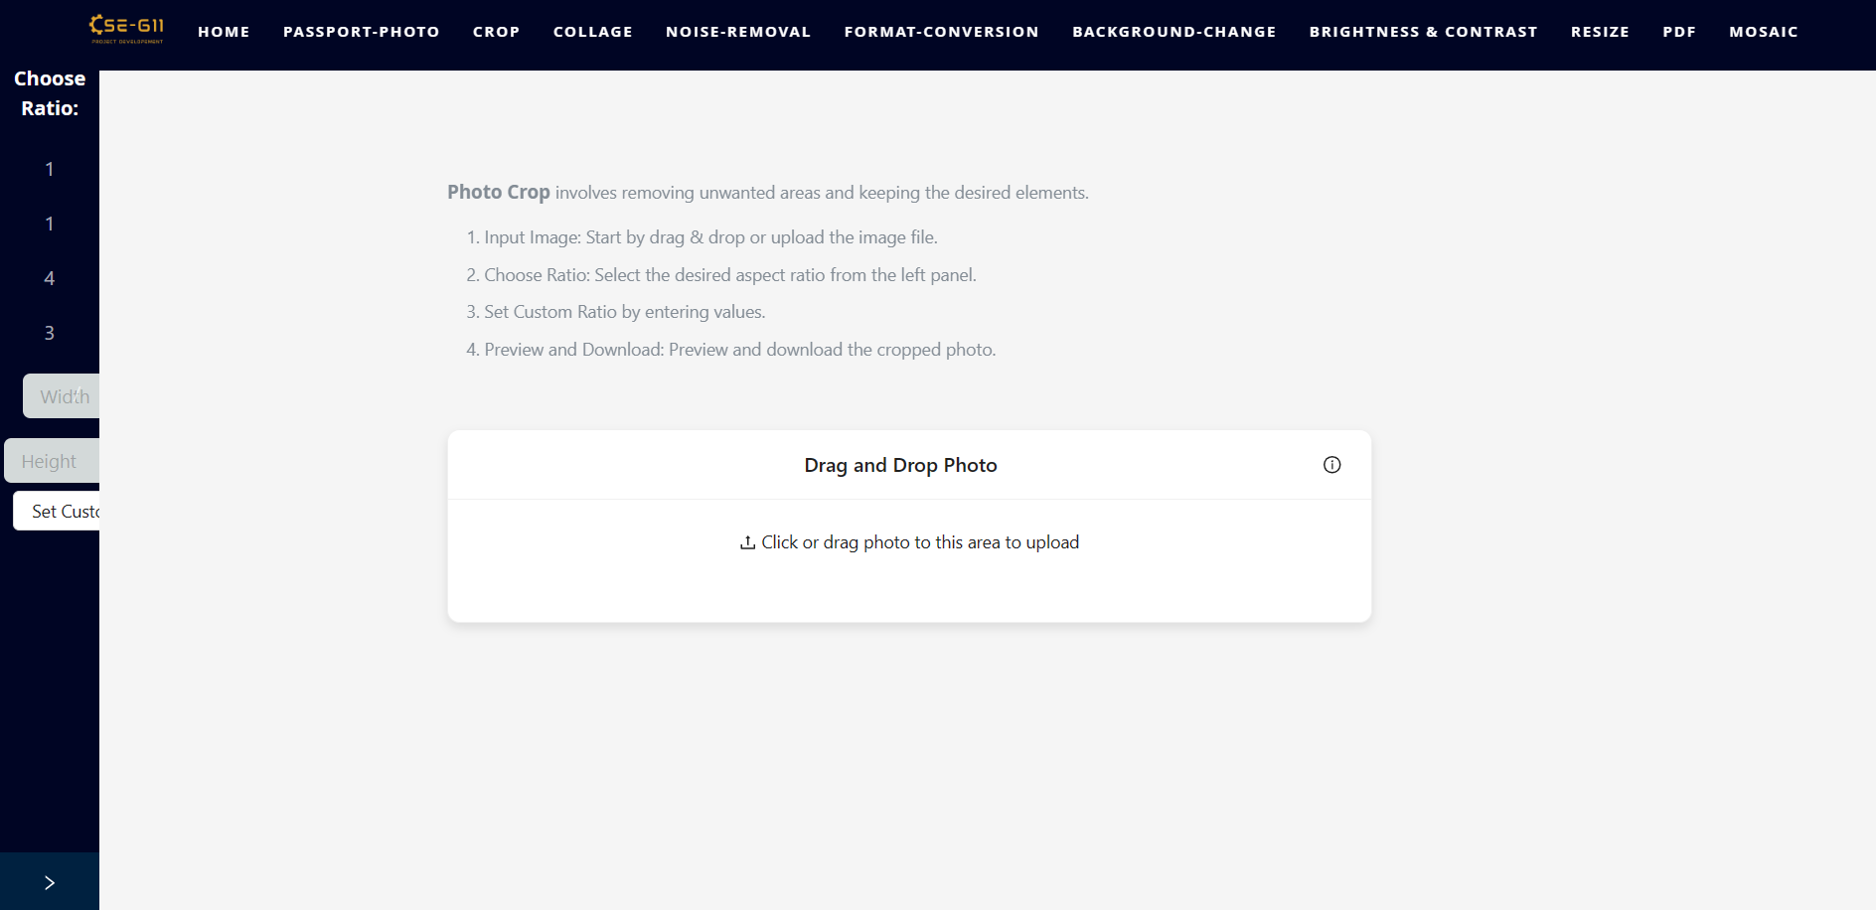
Crop - Before Modernization and Fix

Slide 25
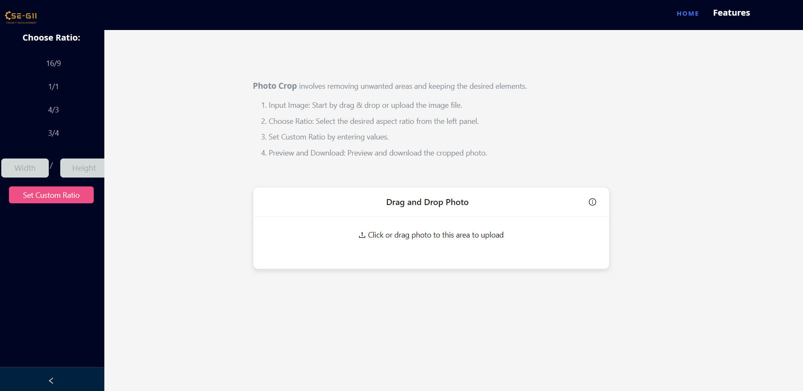
Crop - After Modernization and Fix

Slide 26
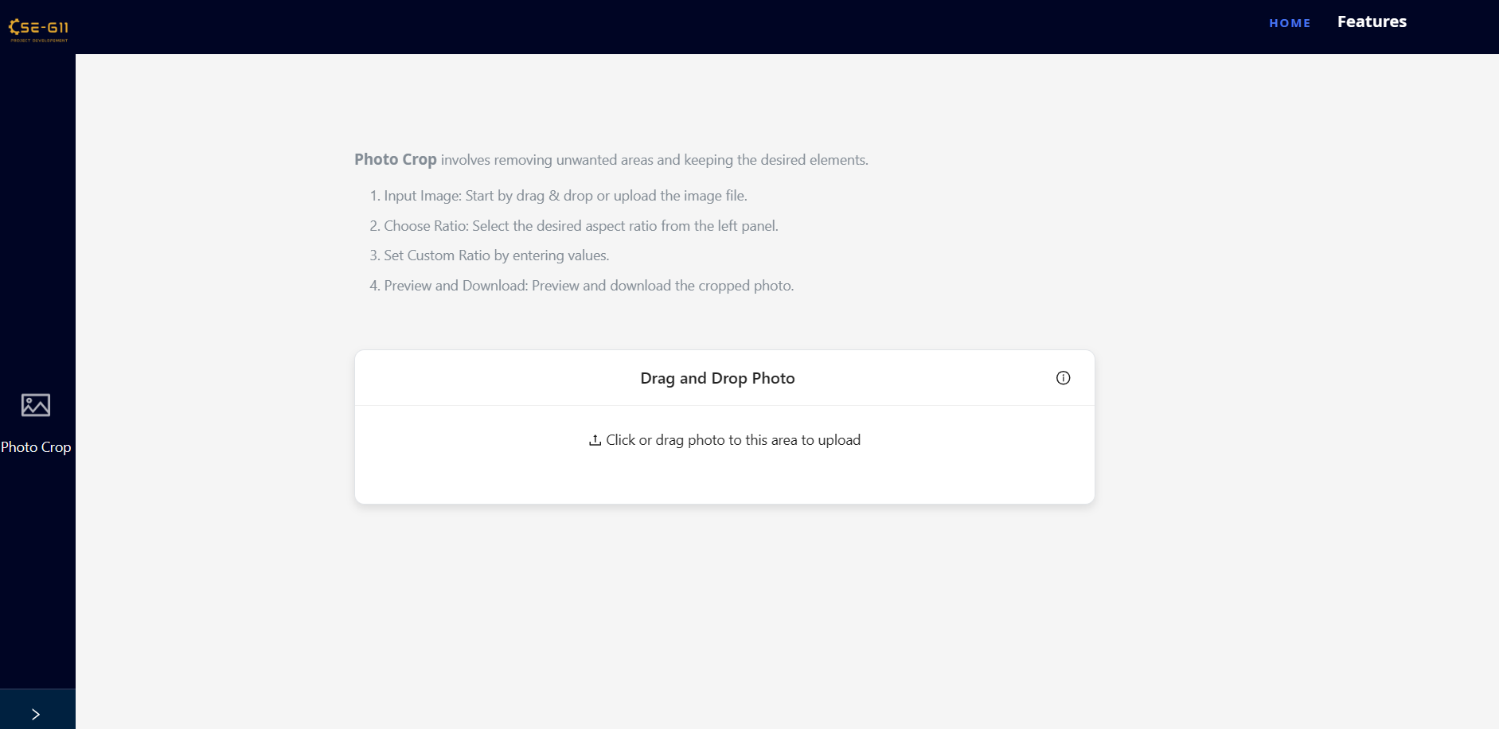
Crop - After Modernization and Fix

Slide 27
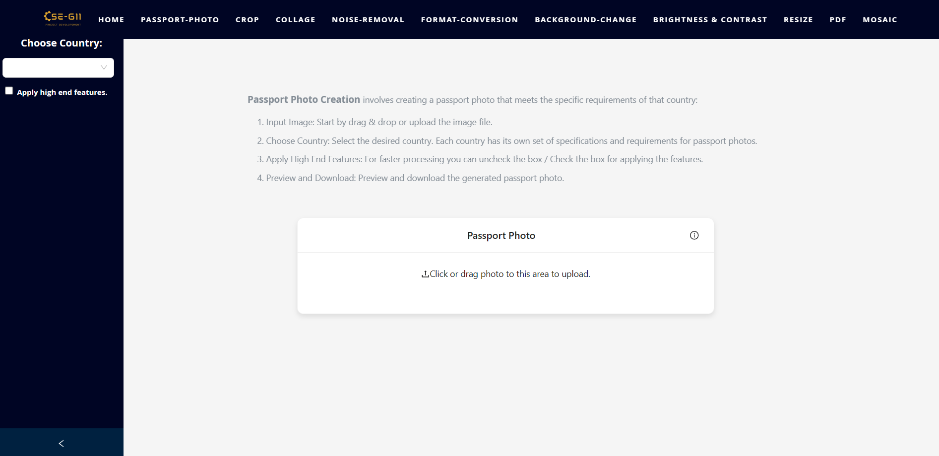
Passport Photo - Before Modernization and Fix

Slide 28
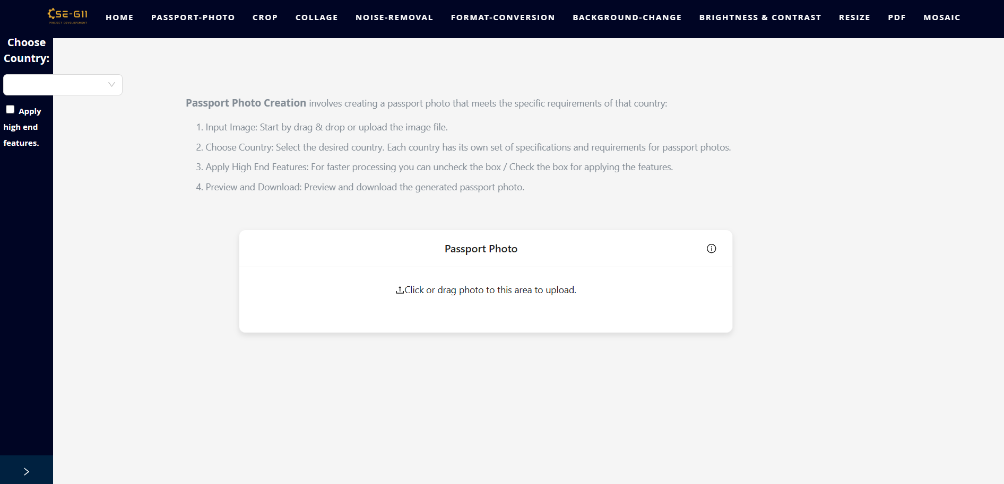
Passport Photo - Before Modernization and Fix

Slide 29
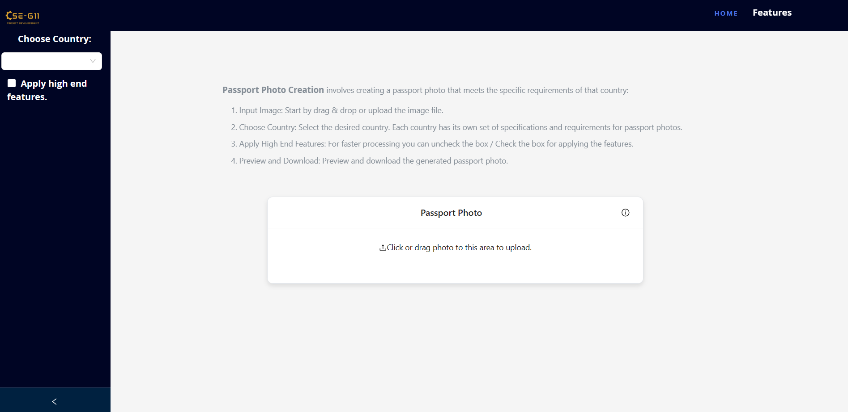
Passport Photo - After Modernization and Fix

Slide 30
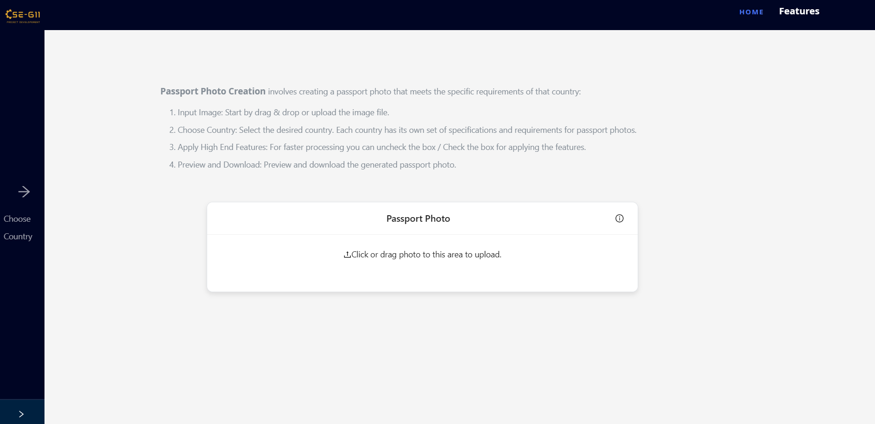
Passport Photo - After Modernization and Fix

Slide 31
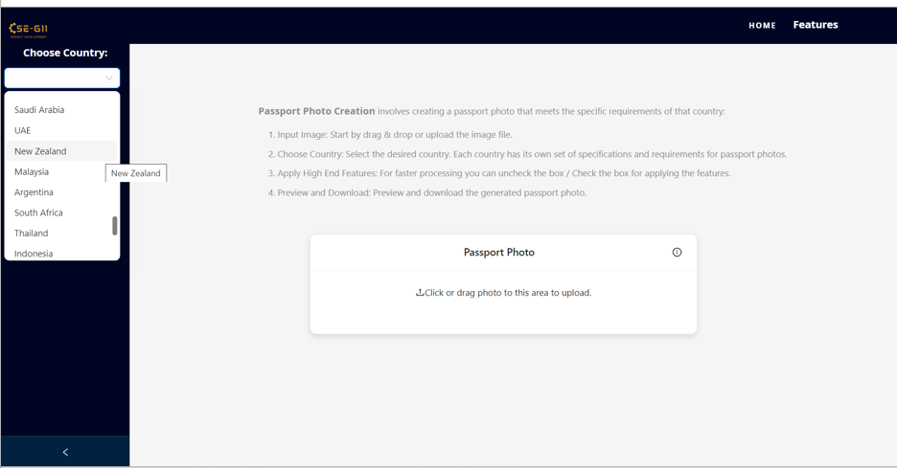
Passport Photo - Supports More Countries

Slide 32
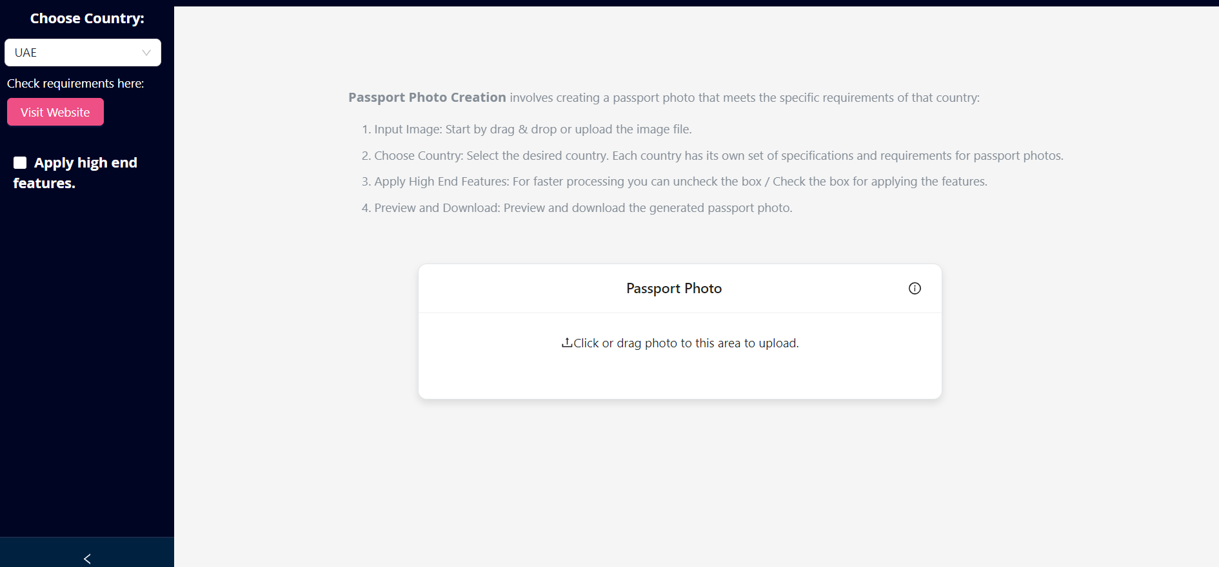
Passport Photo - Added Country Specific Requirements

Slide 33
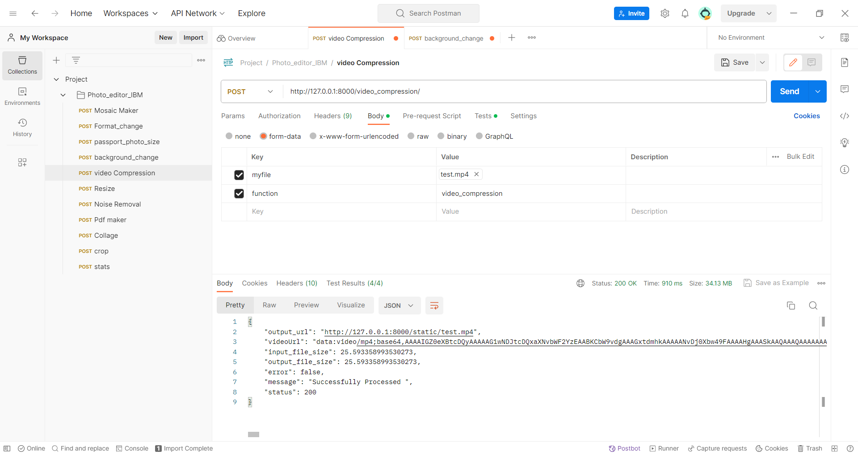
Video Compression End point

Slide 34
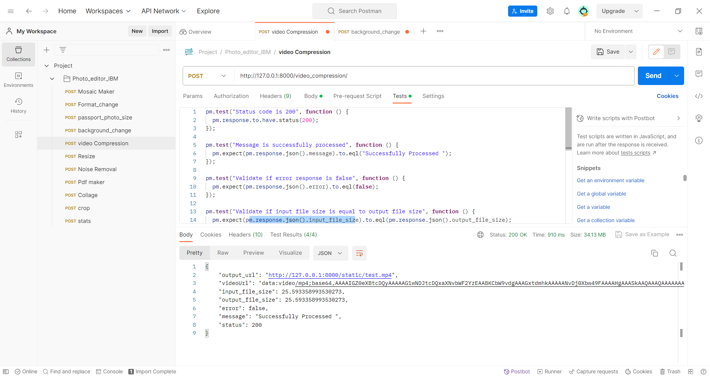

Slide 35

Image Compression - Before Frontend Build

Slide 36
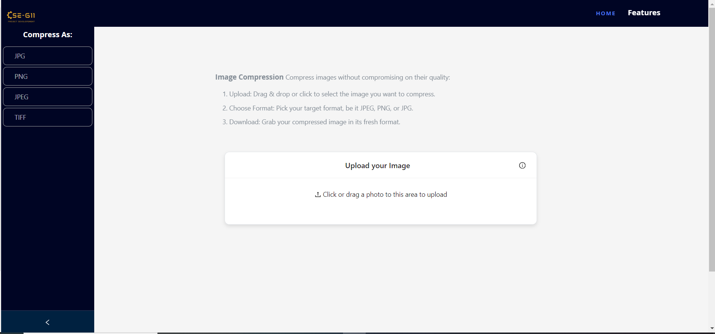
Image Compression - After Frontend Build

Slide 37
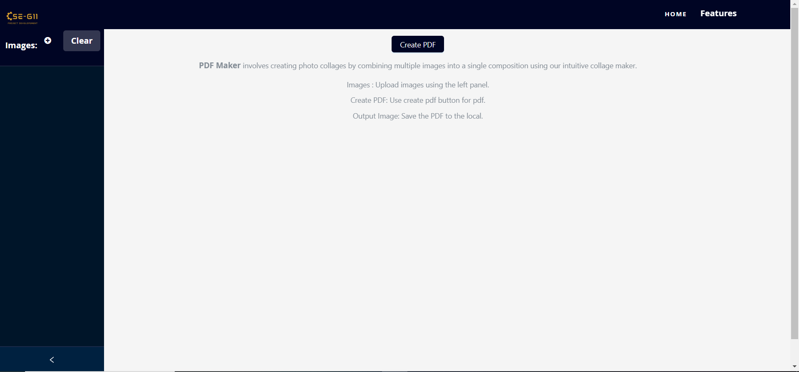
PDF page - Before fix

Slide 38
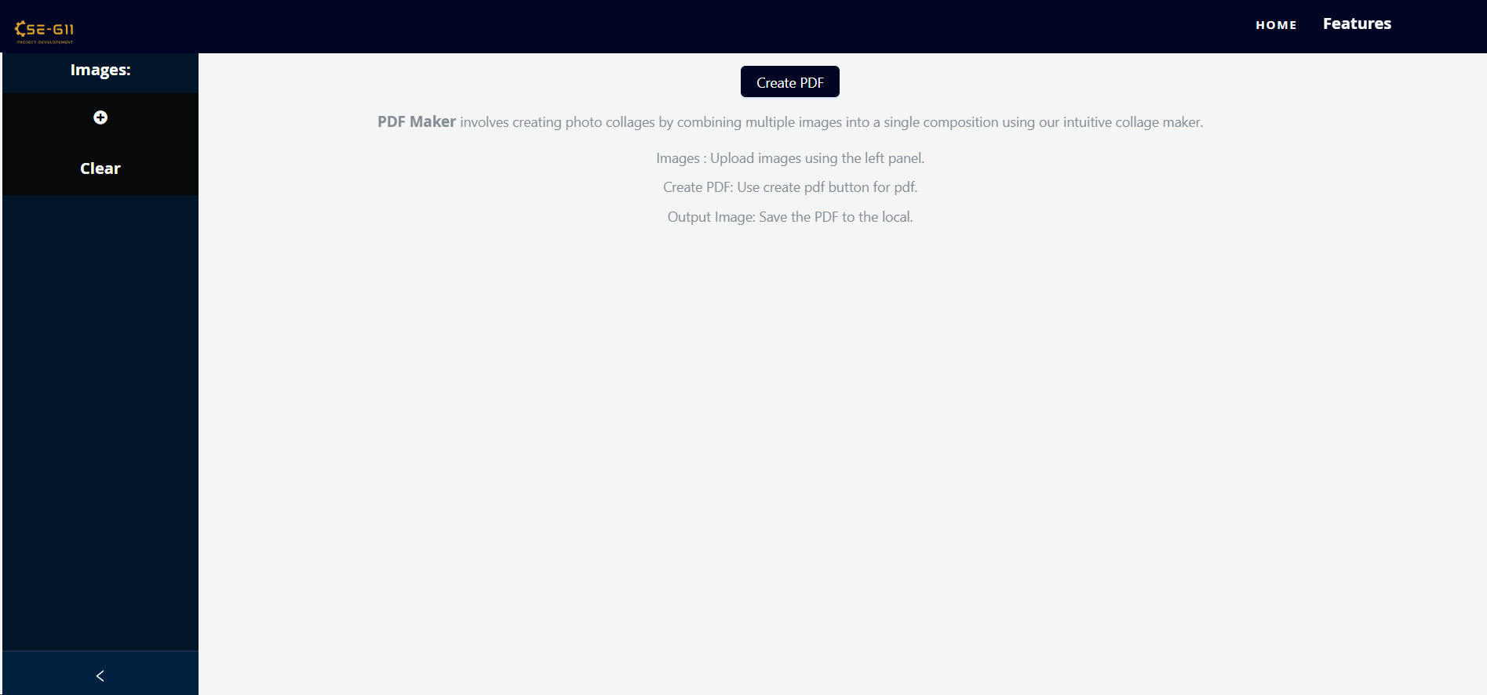
PDF page - After fix

Slide 39
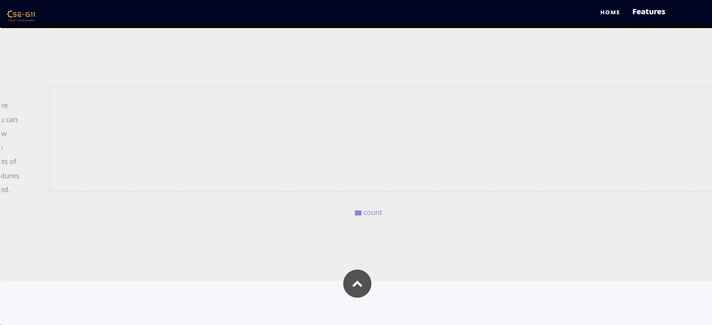
Home page - Before fix

Slide 40
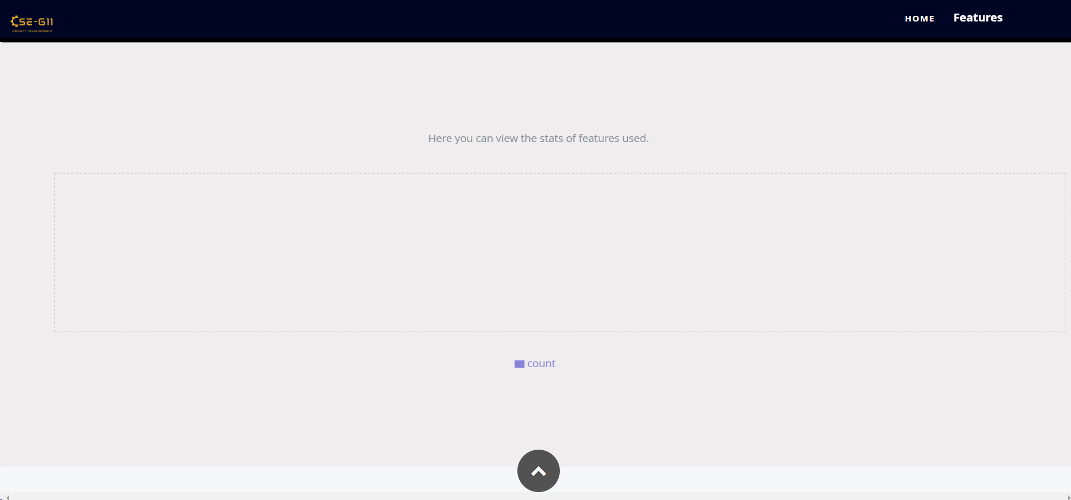
Home page - After fix

Slide 41
Other fixes and implementations:
Delete button confirmation pop-up implemented on all pages.
Also implemented above pop-up for template deletion on mosaic page.
Bug fixes on Collage page.
The individual clear button of each image was clearing all images instead of a single image when more than two images were being added.
A few more frontend layout enhancements.

Slide 42
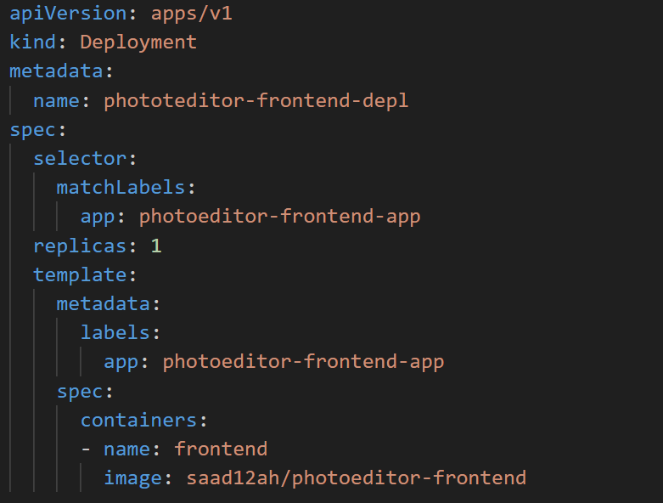
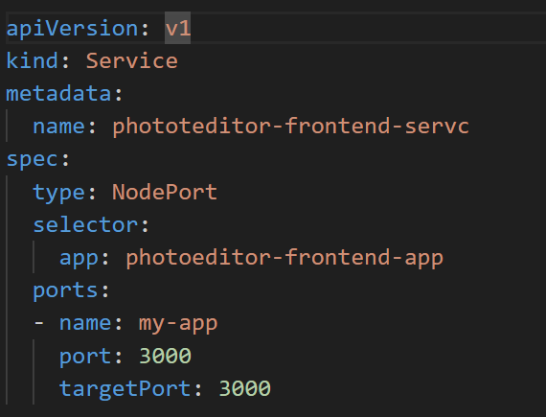
K8s Deployment

Slide 43
Thank you

